Slide 1
0
GTM Forum: Grid Edge East 2019
April 3, 2019
Durham, NC

Slide 2
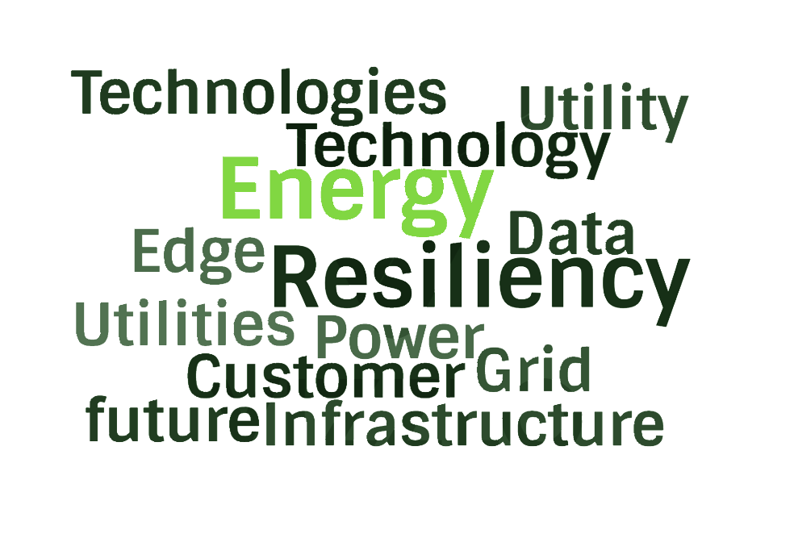
What’s in a word?
The top words of Grid Edge East 2019 Agenda

Let’s talk about
Power Flow


Slide 3
Power Flow’s Relevance to Edge Security
Grid Edge East 2019 Agenda
When power flow is not controlled, it becomes the vulnerability.
There are numerous ways to alter power flow with unknowable, but harmful effects to the system.
Modern cyber threats target power flow because it causes the most disruption.

Slide 4
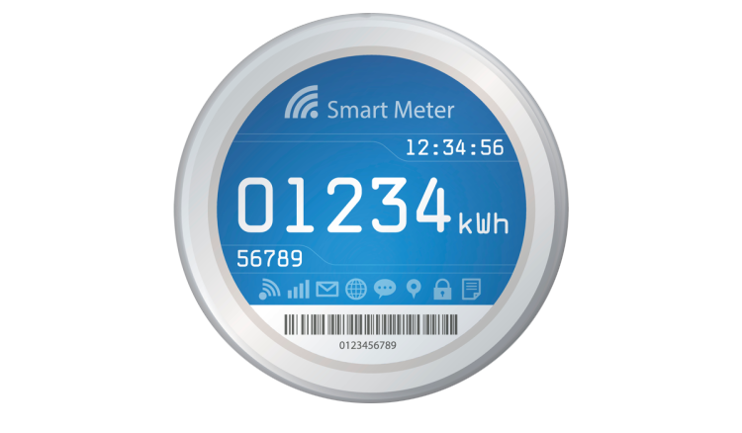
Power Networks are Exposed Through Connection
0
There are two sides of the meter...for billing purposes, but where is the line of demarcation for power flow?
Reactions to aggressive consumer side power consumption traverses meter causing capacity and infrastructure problems.
(reactive power, harmonics, etc.)
Fluctuation upstream traverses meter unimpeded affecting loads and processes
(i.e. swells, sags, etc.).

Slide 5
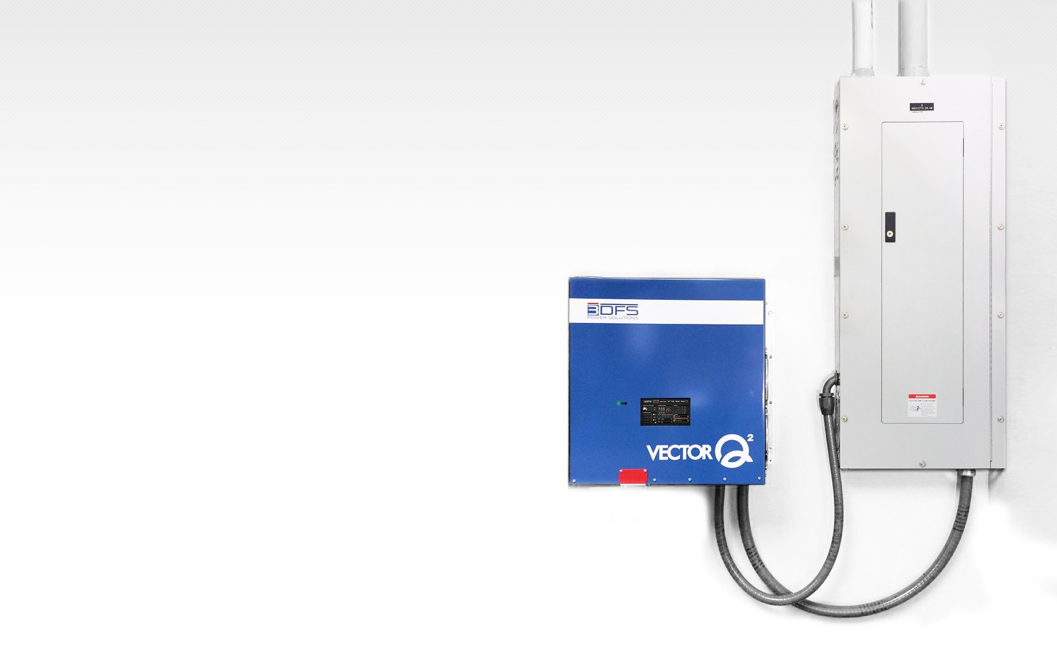
Isolate and Optimize Power Flow with 3DFS
Power flow must not be susceptible to influence. It should be isolated from both:
1. Upstream power fluctuations
2. Aggressive load side
power consumption
Software-Defined Electricity is easily installed embedded intelligence that isolates and optimizes power flow for an entire circuit.

Slide 6
0
Youtube LiveStream
3DFS.COM 919.807.1884 chris@3dfs.com

